Slide 1

Best Research Practices
Dong Yang
NVIDIA

Slide 2
Medical Image Analysis
Motivations
What?
To gain high-level understanding from medical images
Why?
Disease diagnosis, treatment planning and surgical guidance
Applications
Precise radiotherapy (calculate dose distribution, delineate tumours and normal organs)
"COVID-19" screening, etc.

Slide 3
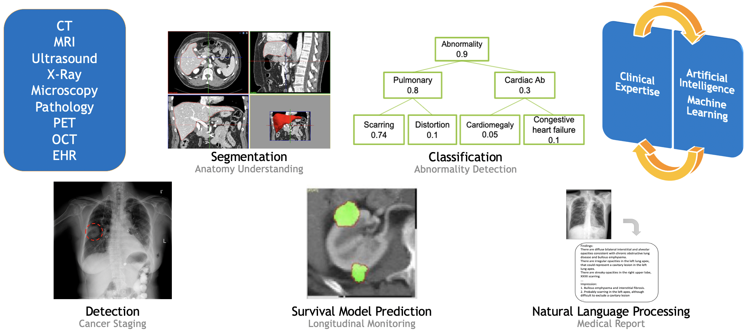
Medical Image Analysis
Applications

Slide 4
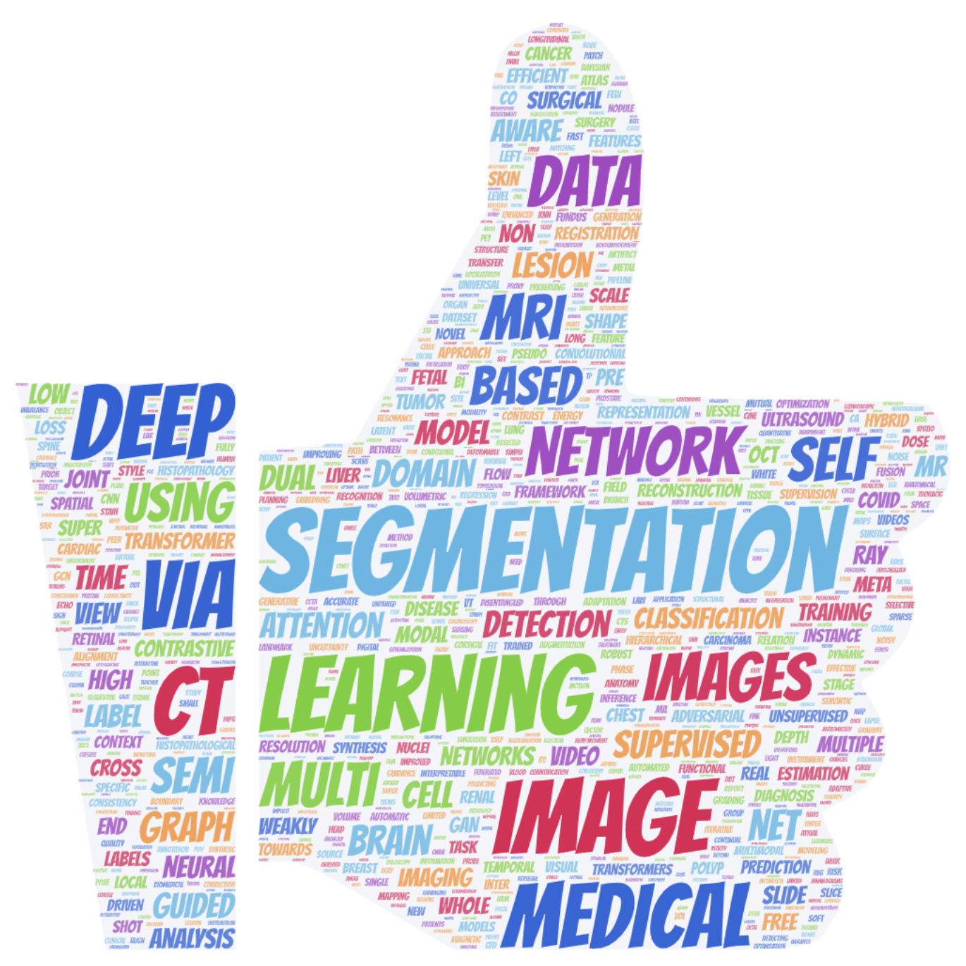
MICCAI 2021 Keywords
Segmentation
Deep
Learning
https://wordart.com/

Slide 5
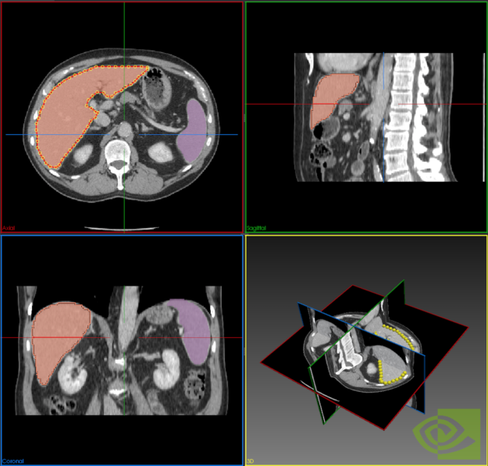
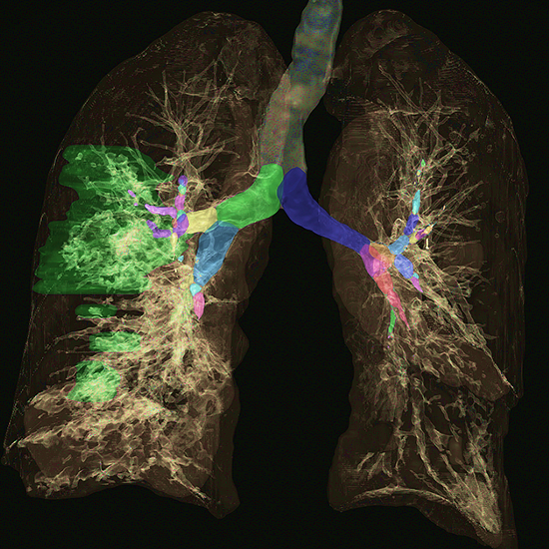
Case Study
3D Medical Image Segmentation
Taking 3D medical images (e.g., CT, MRI) as input to extract 3D structure of organs or tumours
https://devblogs.nvidia.com/annotation-transfer-learning-clara-train/
https://www.nvidia.com/en-us/clara/

Slide 6
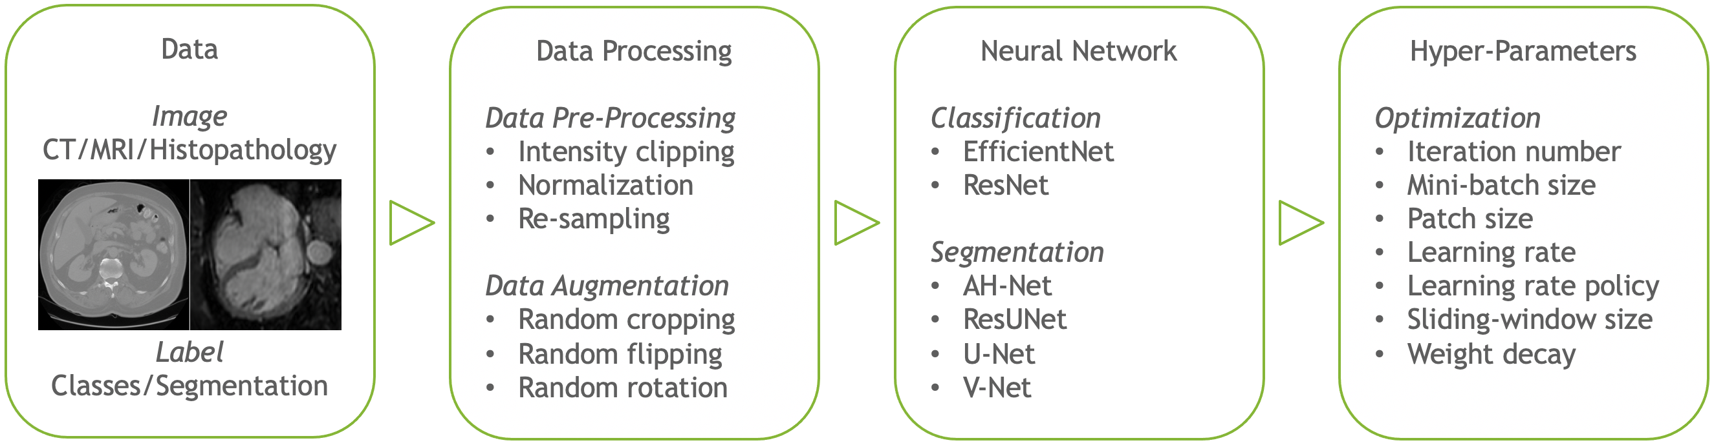
Applications and Algorithms
Model Training
What is the optimal deep learning solution in medical imaging?

Slide 7
Large-Scale Medical Image Segmentation
Challenges
Diversity: Various clinical applications
Different anatomical objects in different image modalities
Hard to collect large-scale pixel-level annotation
e.g., takes hours or days to accomplish multi-organ annotation in whole-body CT
Large GPU computation resource request
High dimensional medical images

Slide 8
Solutions? Yes

Slide 9
Case Study
3D Spleen CT Segmentation
41 abdominal CT volumes from public domain (Medical Segmentation Decathlon) with spleen region annotation
32 for training
9 for validation
“State-of-the-art” performance around Dice’s score 0.95
Publicly available implementation takes several hours to train segmentation models and reach “state-of-the-art” performance

Slide 10
Case Study
3D Spleen CT Segmentation
41 abdominal CT volumes from public domain (Medical Segmentation Decathlon) with spleen region annotation
32 for training
9 for validation
“State-of-the-art” performance around Dice’s score 0.95
Publicly available implementation takes several hours to train segmentation models and reach “state-of-the-art” performance
But now, we can achieve it within one minute using U-Net on one single GPU

Slide 11
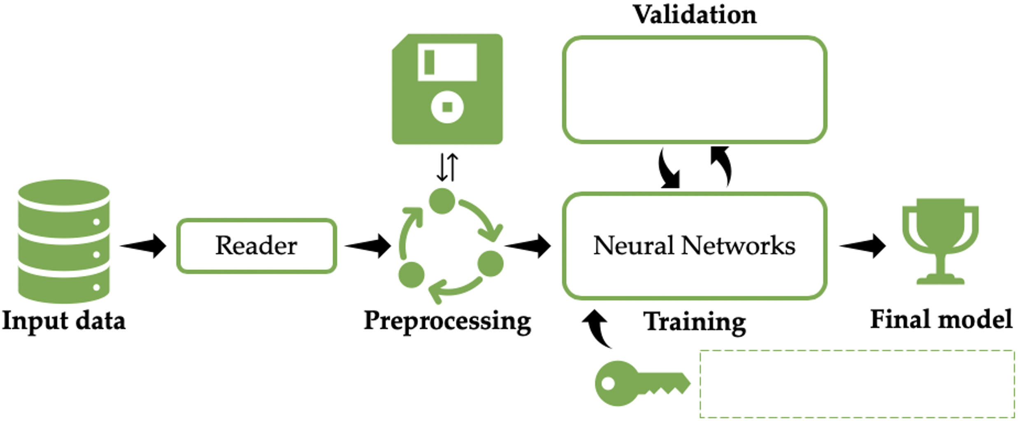
Case Study
3D Spleen CT Segmentation
RAM
Sliding-Window Inference
Loss Function, Optimizer, Learning Rate, etc.

Slide 12
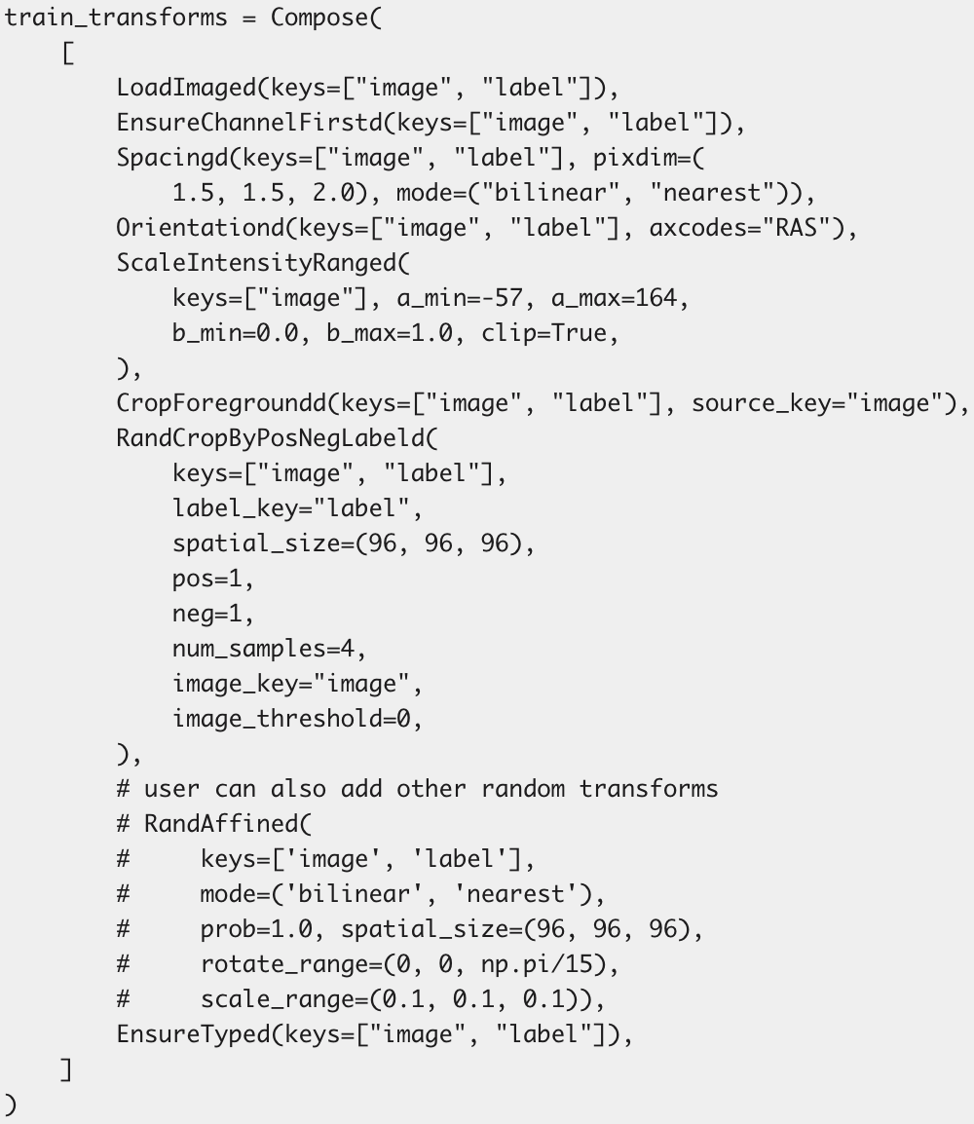
3D Spleen CT Segmentation
Pre-Processing and Augmentation
“Spacingd”
Resampling | Physical meanings
“Orientationd”
Aligning imaging origins
“ScaleIntensityRanged”
Intensity window | Hounsfield units (HU)
“RandCropbyPosNegLabeld”
Handling various image size
Balancing training samples

Slide 13
3D Spleen CT Segmentation
Automated Mixed Precision (AMP)

Slide 14
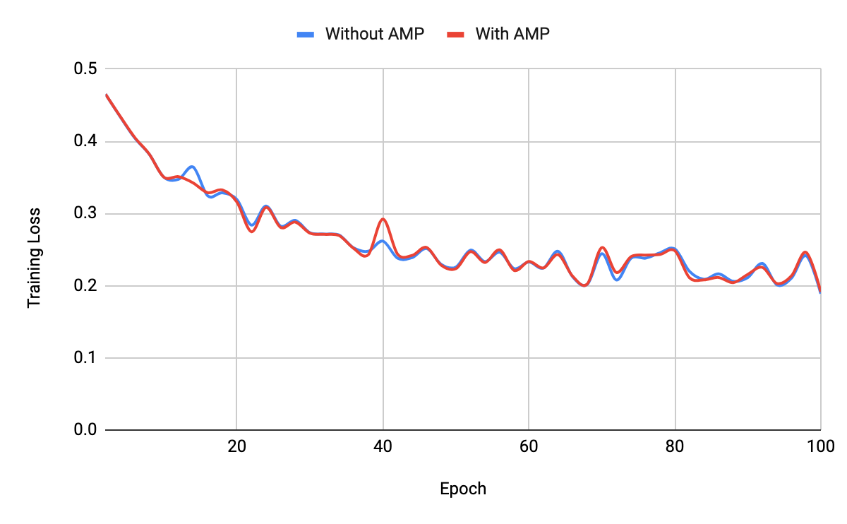
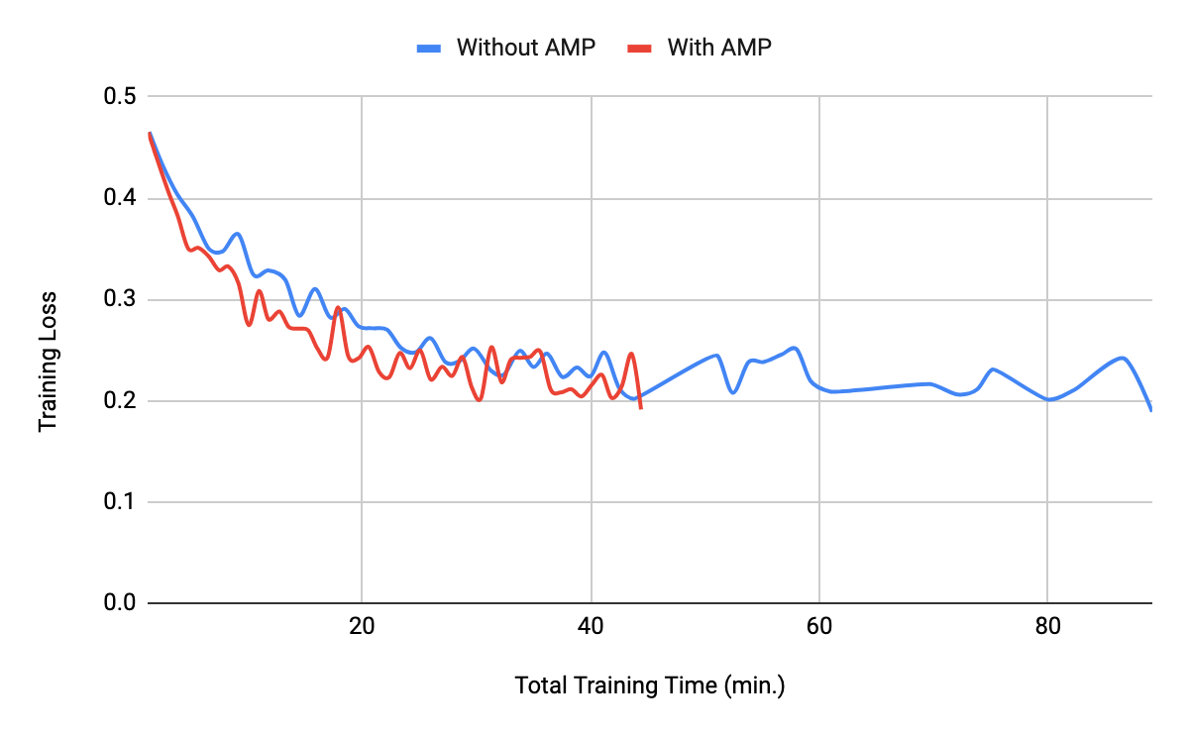
3D Spleen CT Segmentation
Automated Mixed Precision (AMP)

Slide 15
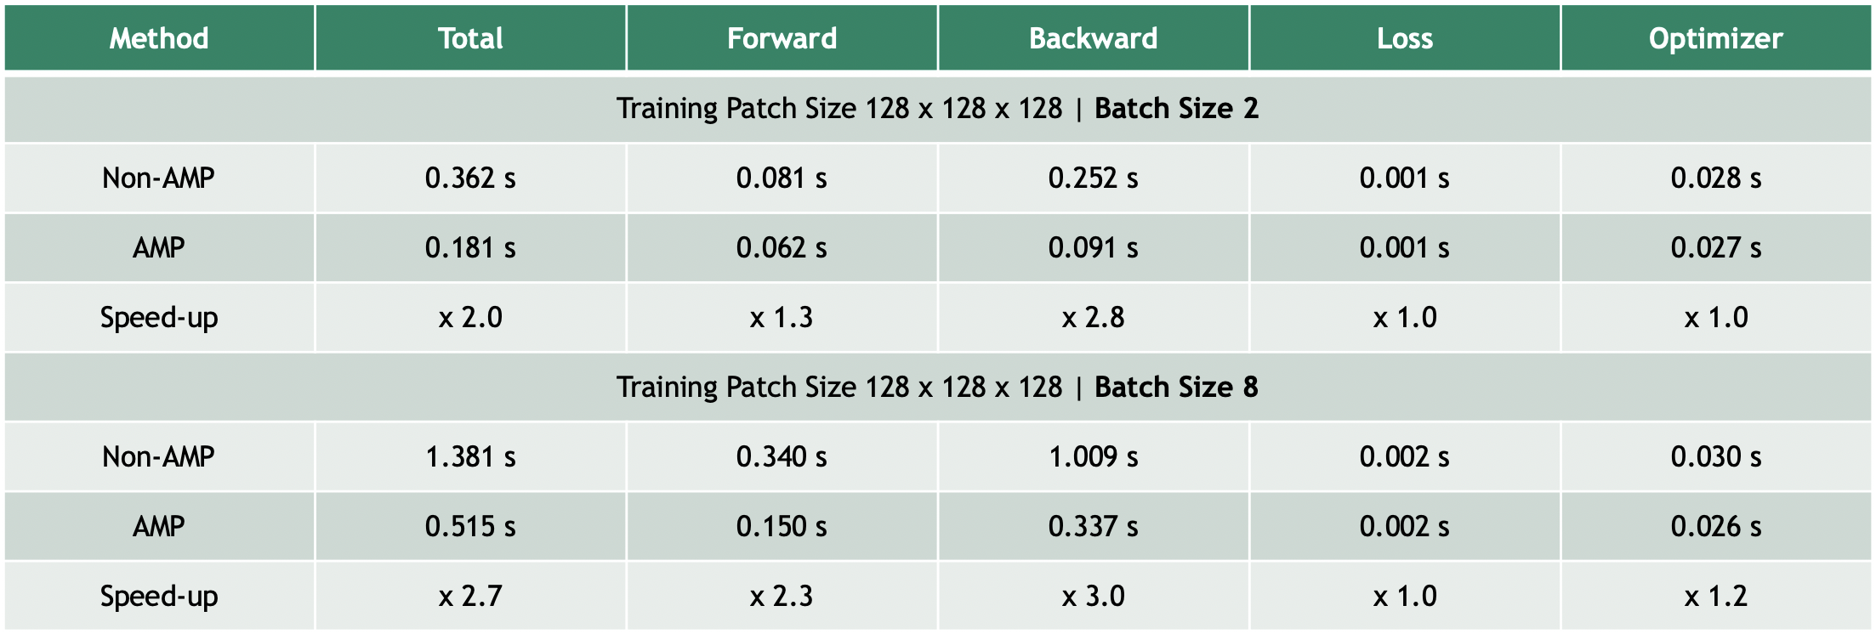
3D Spleen CT Segmentation
Automated Mixed Precision (AMP)

Slide 16
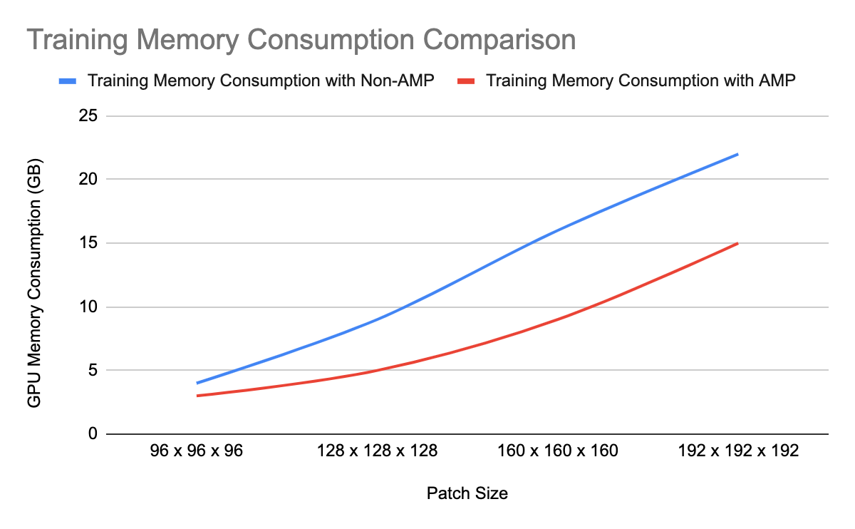
3D Spleen CT Segmentation
Automated Mixed Precision (AMP)

Slide 17
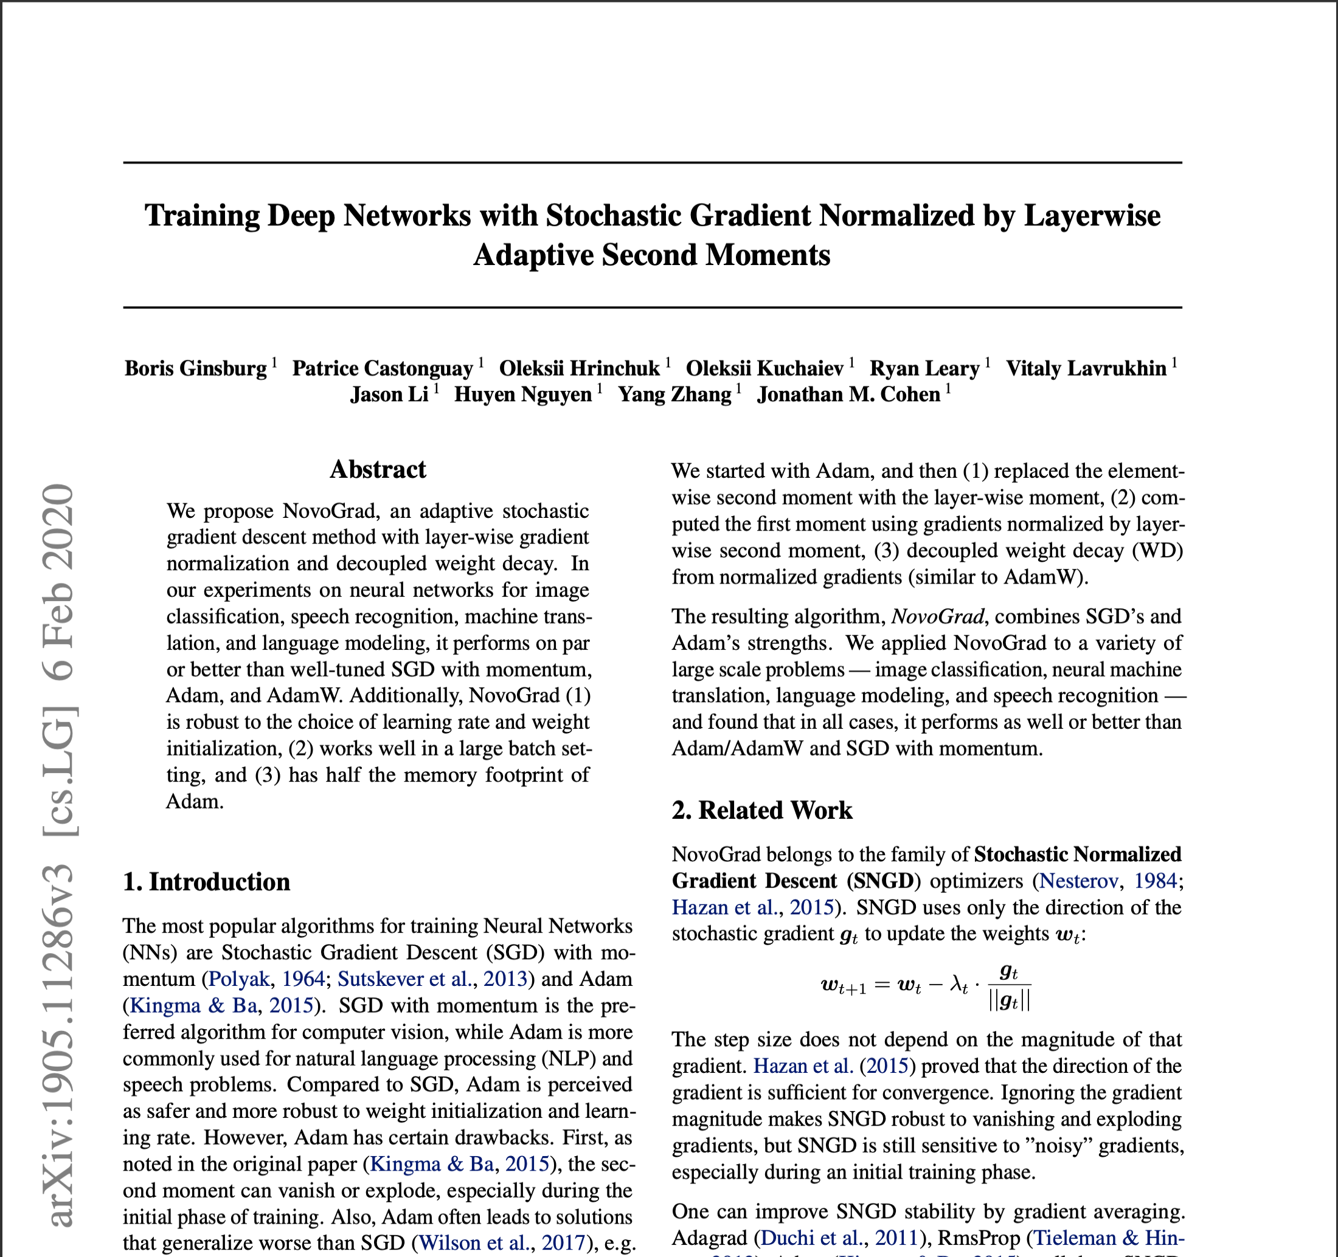
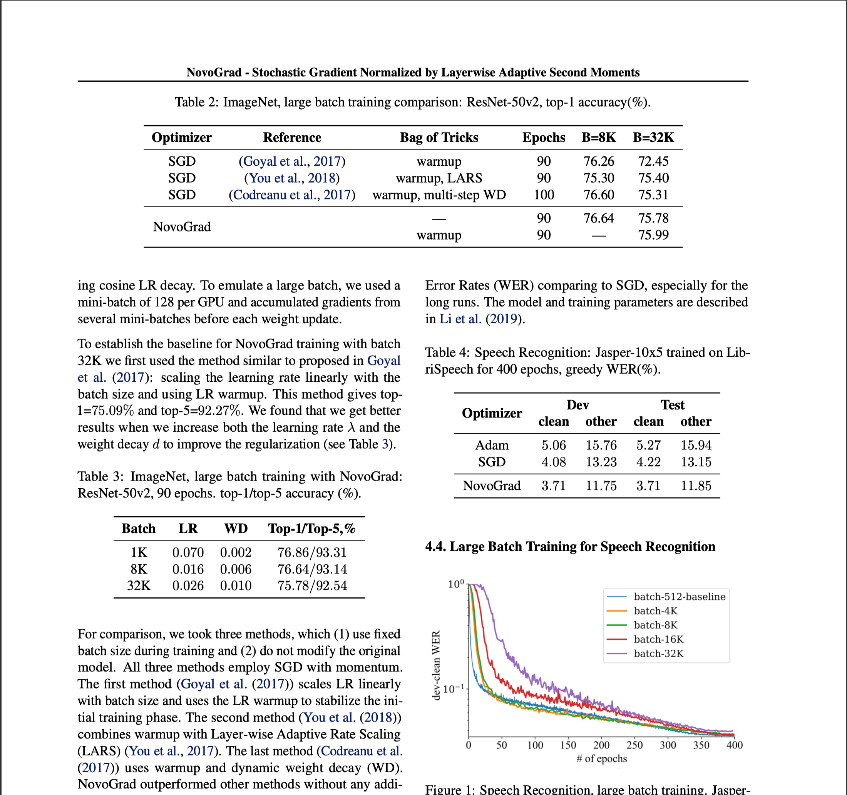
3D Spleen CT Segmentation
Novograd Optimizer

Slide 18
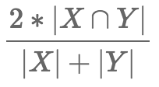
3D Spleen CT Segmentation
Loss function
Dice loss = 1 – Dice Score = 1 -
DiceLoss -> DiceCELoss (dice loss and cross-entropy loss)
“One-line change”:
Before
loss_function = DiceLoss(to_onehot_y=True, softmax=True)
After
loss_function = DiceCELoss(to_onehot_y=True, softmax=True, squared_pred=True, batch=True)

Slide 19
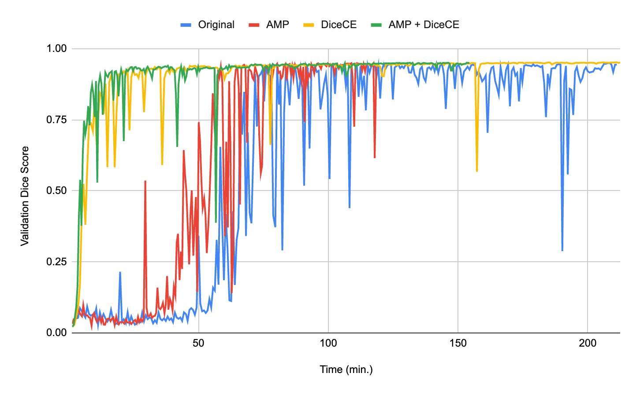
3D Spleen CT Segmentation
Loss function

Slide 20
3D Spleen CT Segmentation
Implementation Improvement
(fully) GPU based
Data caching
Data pre-processing
Data augmentation
Sliding-window inference
etc.
No CPU operations involved

Slide 21
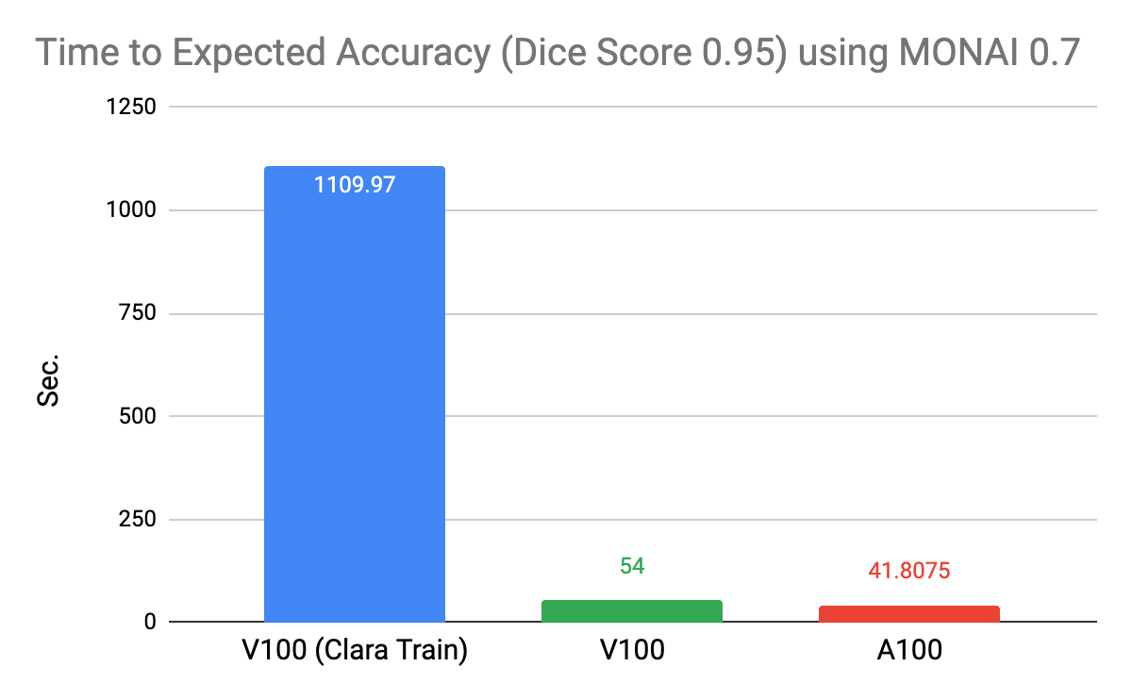
3D Spleen CT Segmentation
Results

Slide 22
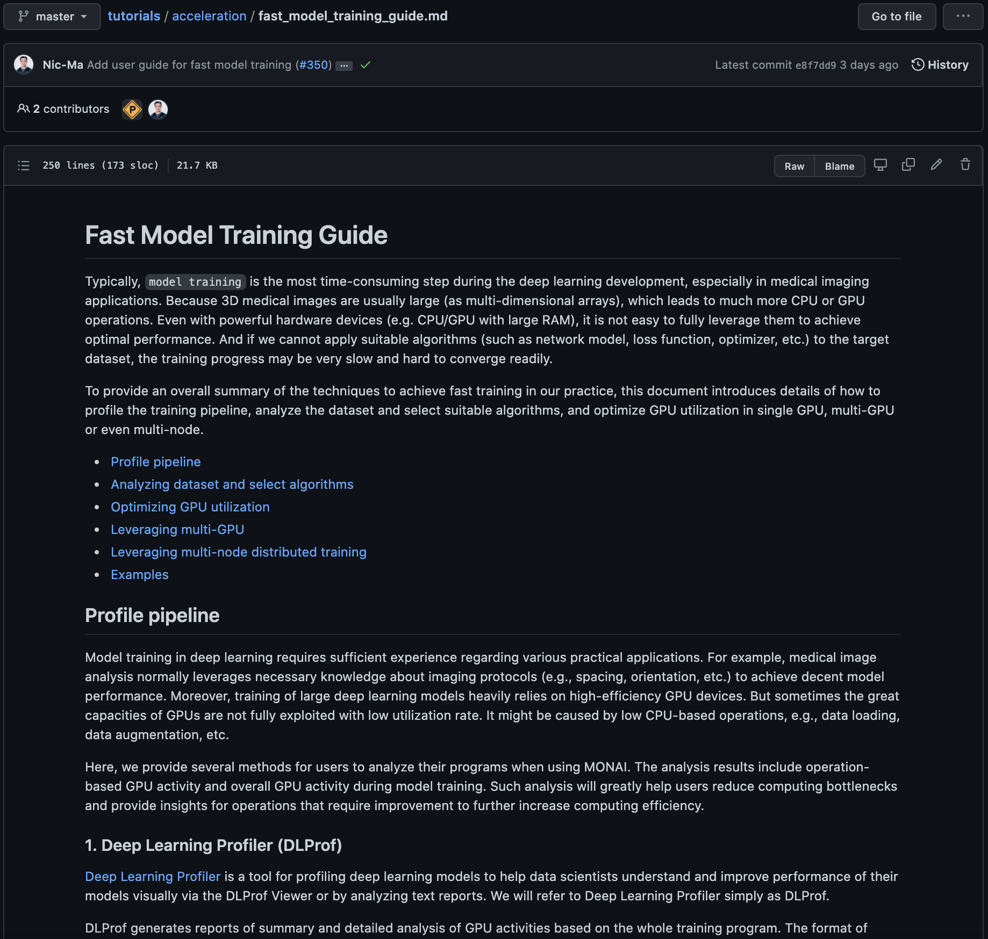
3D Spleen CT Segmentation
Tutorial

Slide 23
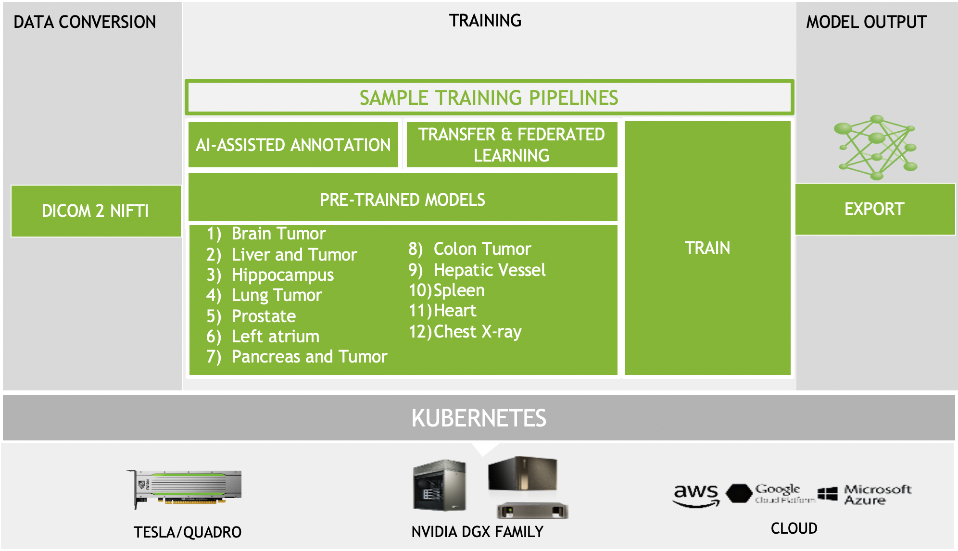
NVIDIA Clara Medical Imaging
Clara Train SDK v4.0

Slide 24
Advanced Topics

Slide 25
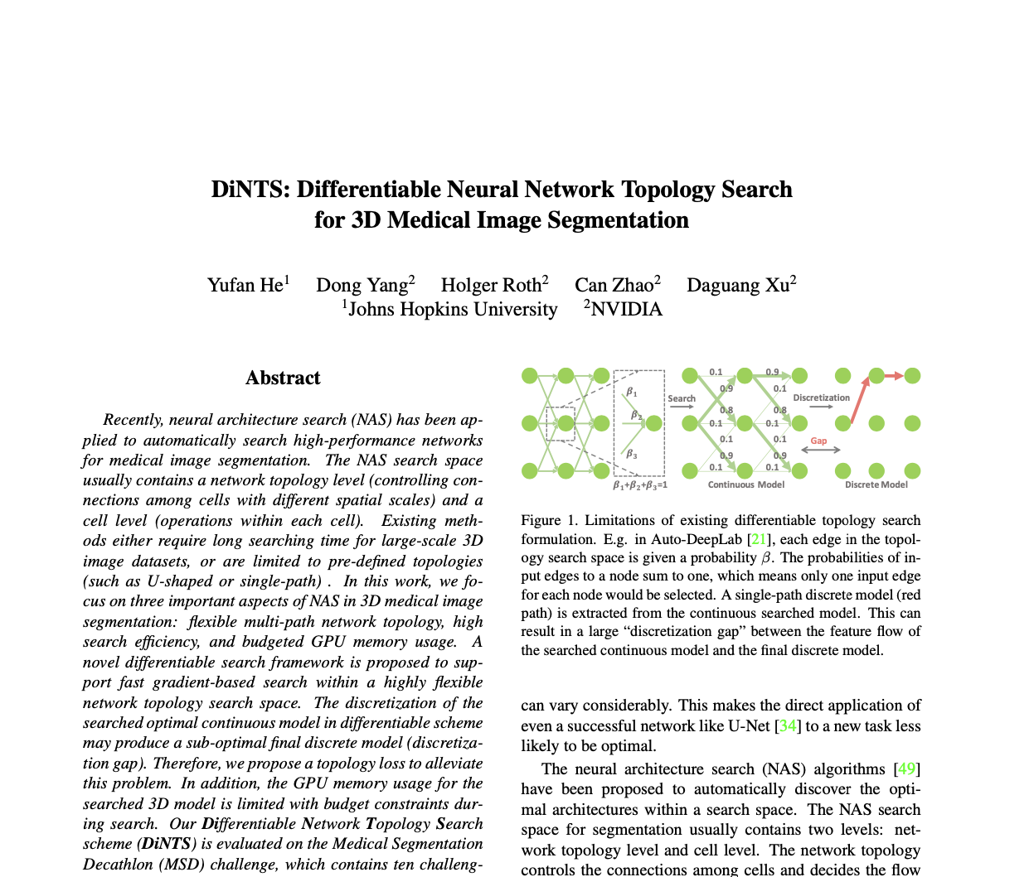
Search for Optimal Neural Network Architecture
Oral Presentation in CVPR 2021

Slide 26
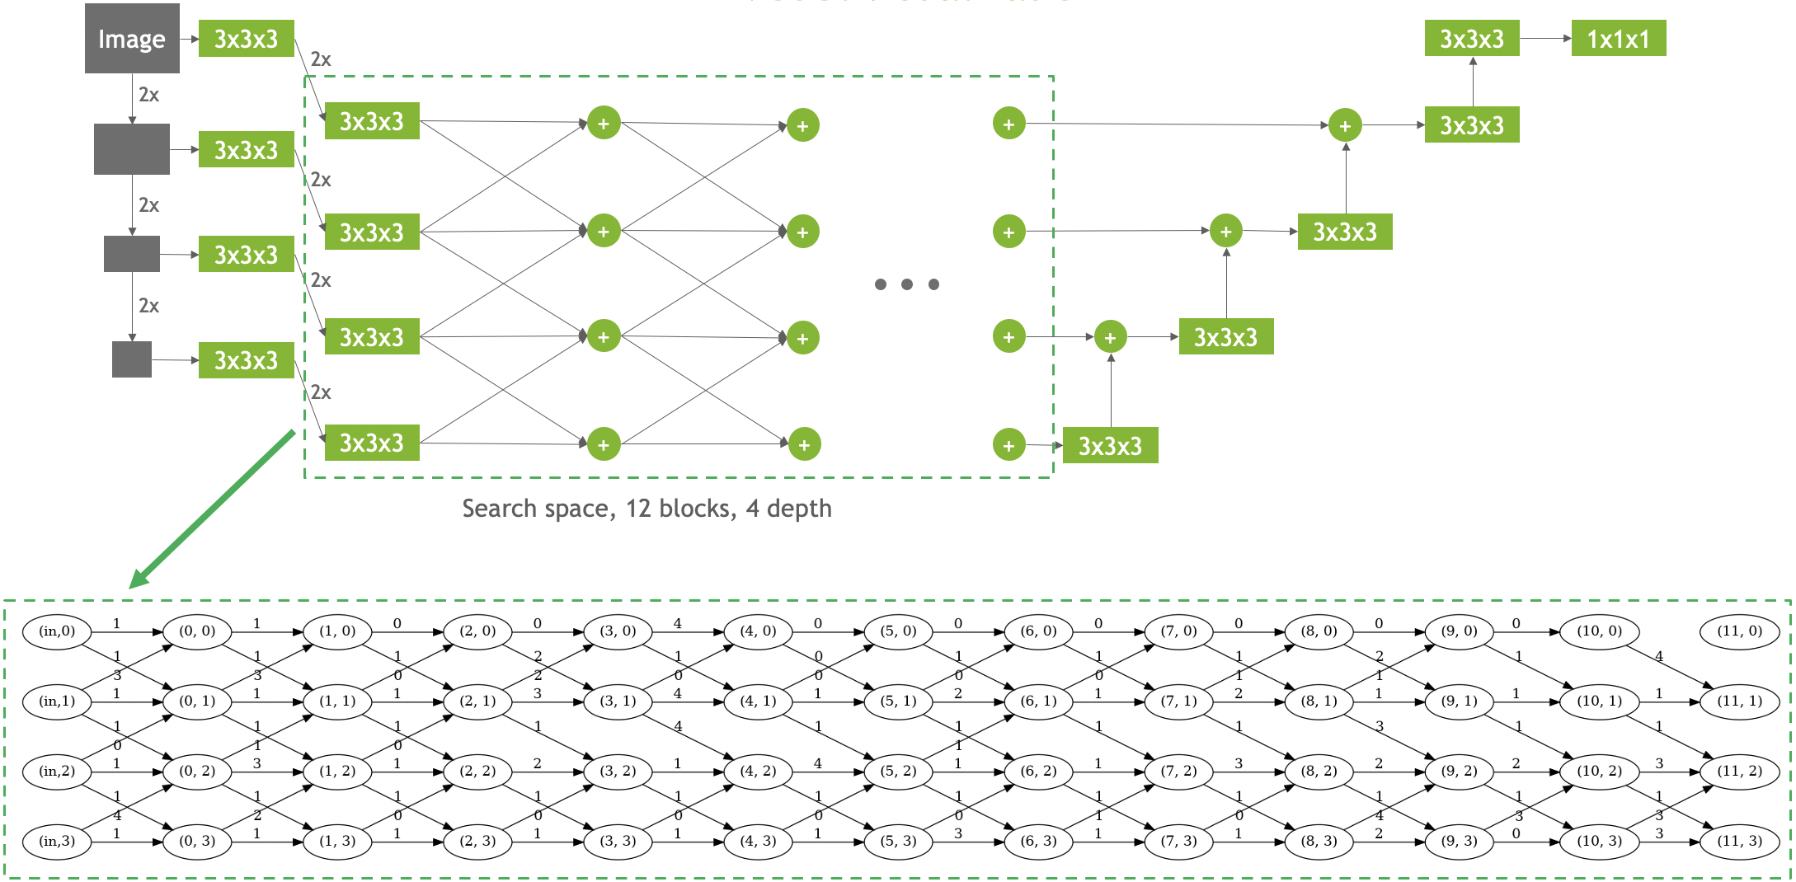

Slide 27
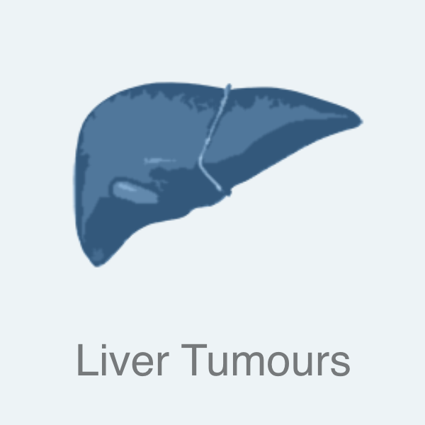
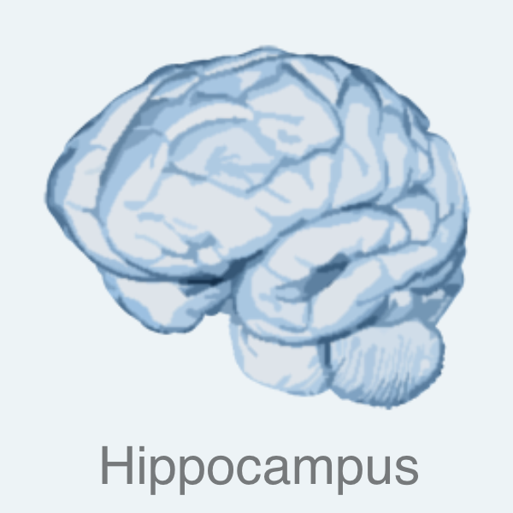
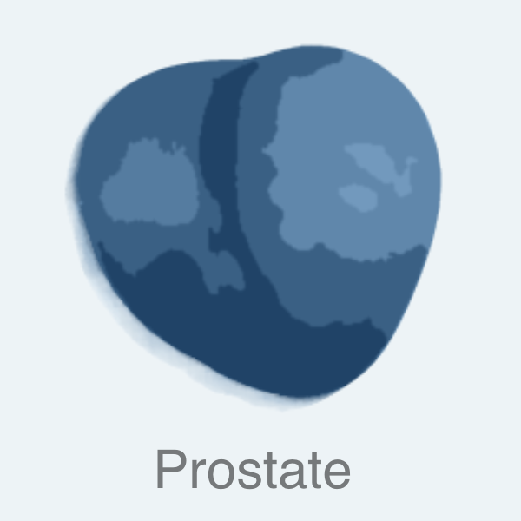
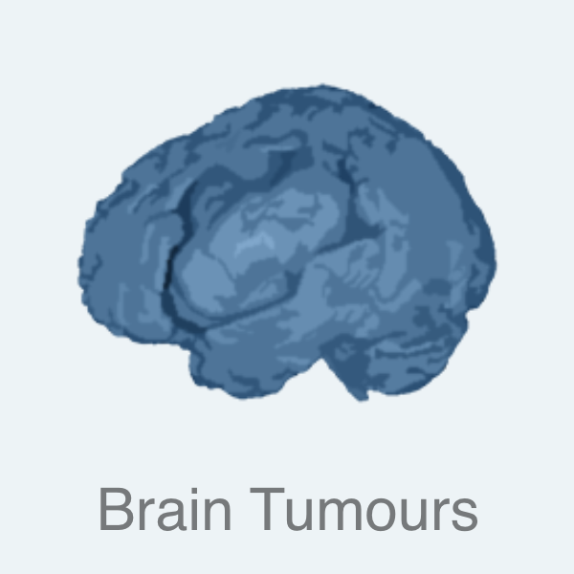
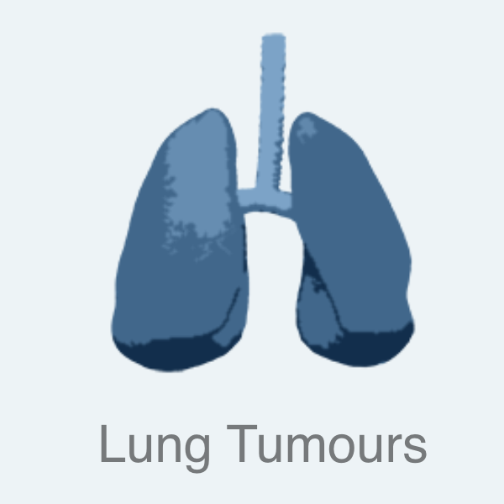
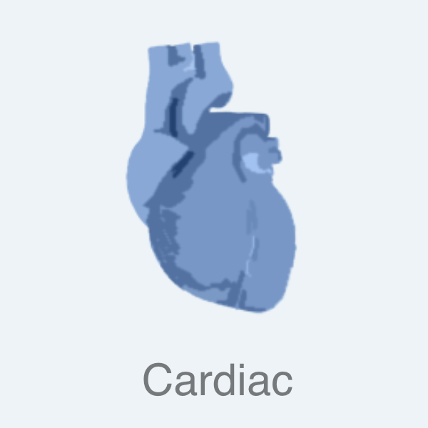
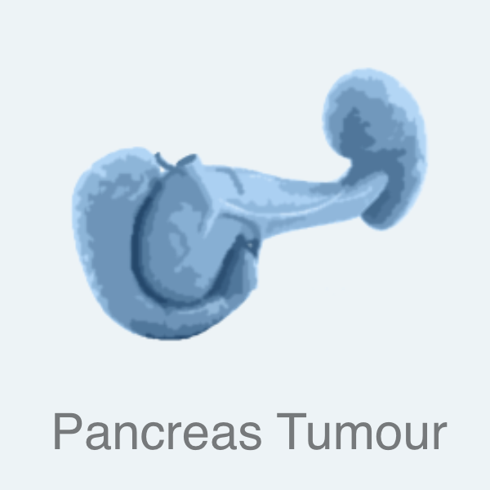
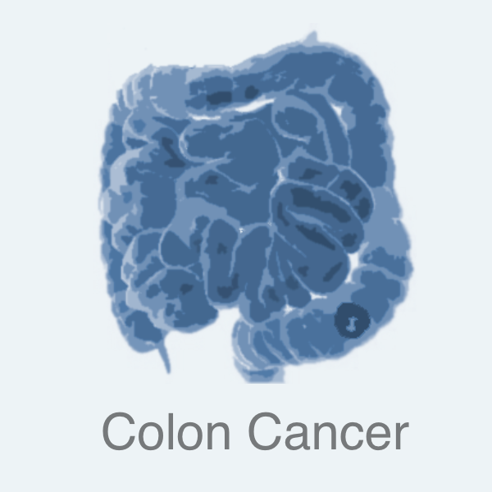
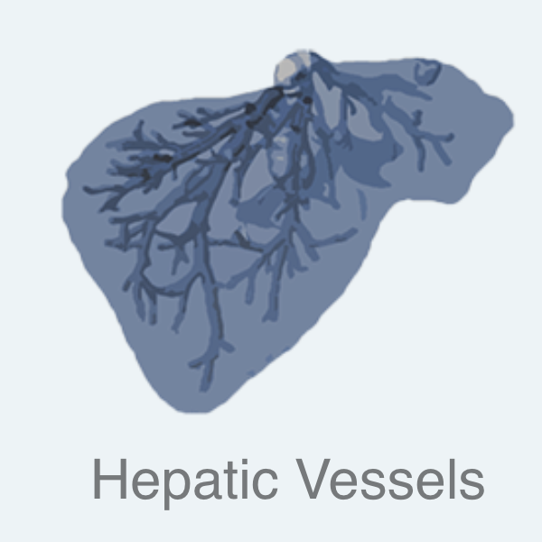
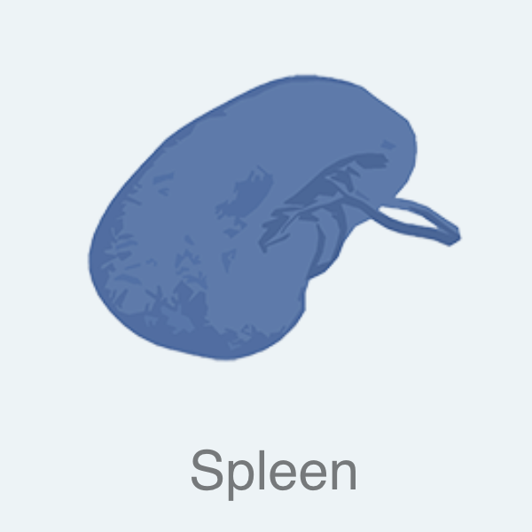
Dataset
Medical Segmentation Decathlon (MSD)
Public challenge with 10 different tasks of 3D medical image segmentation

Slide 28
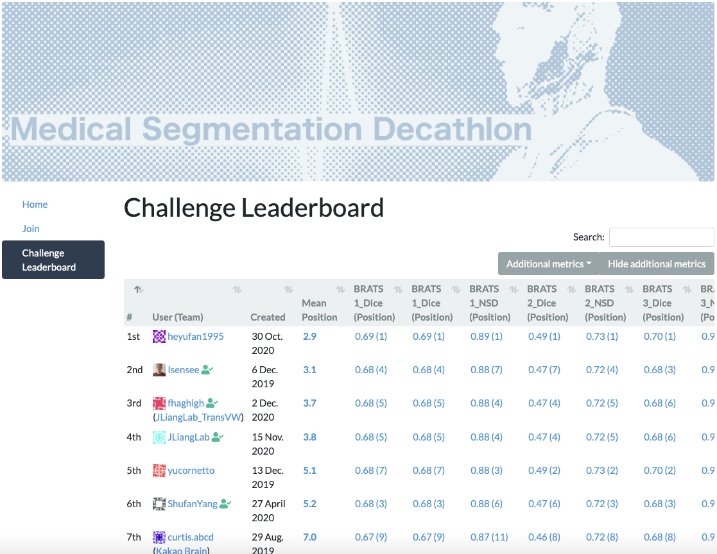
DiNTS
Work-in-progress for future release

Slide 29
What’s more?

Slide 30
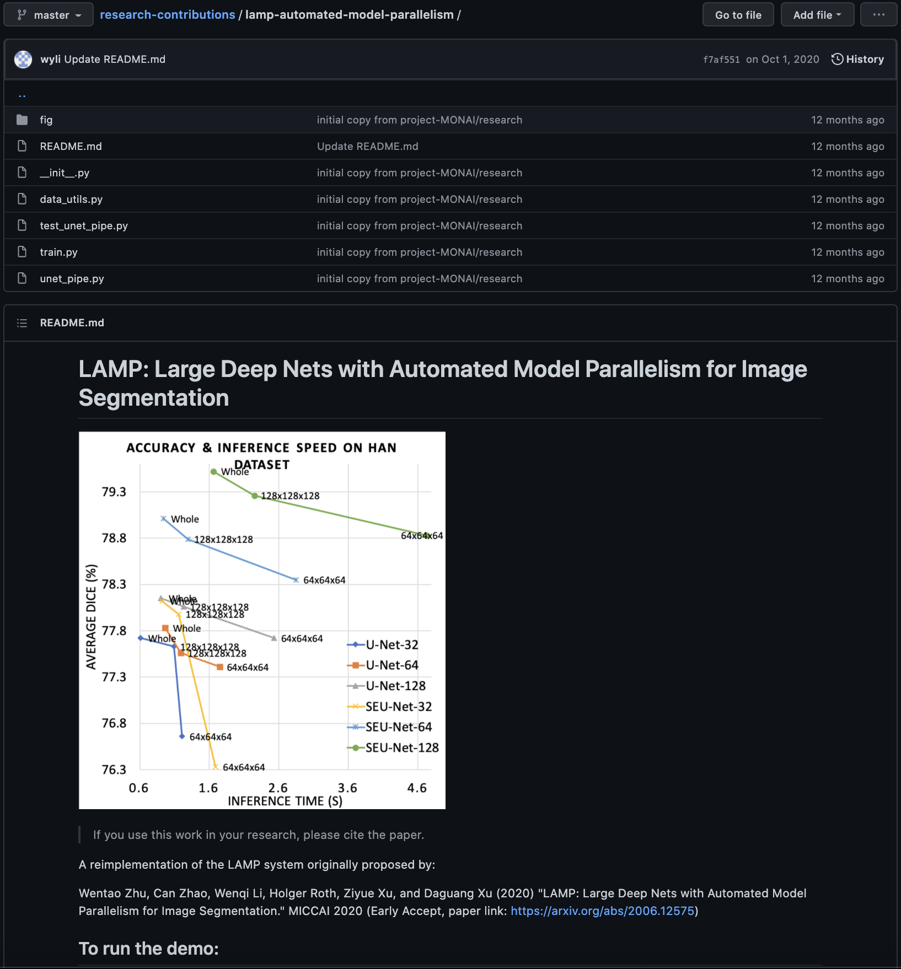

Slide 31
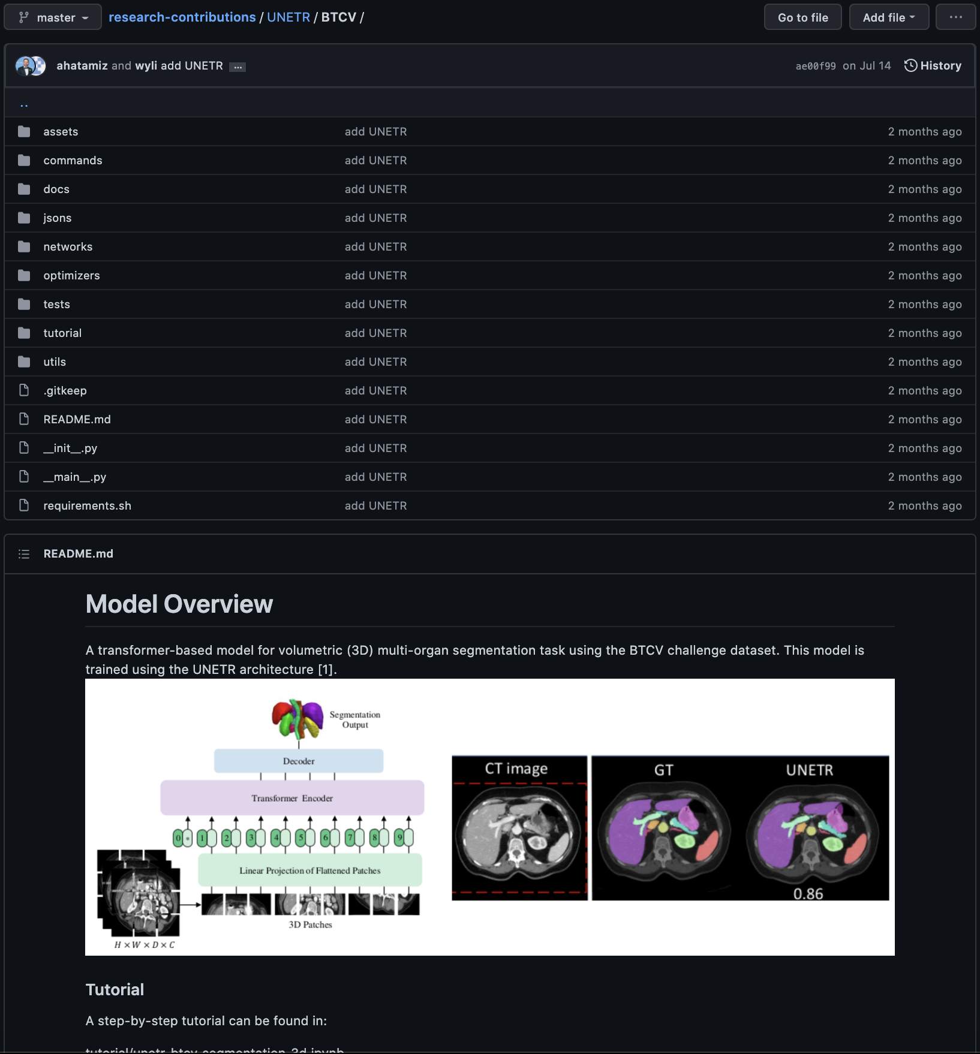

Slide 32
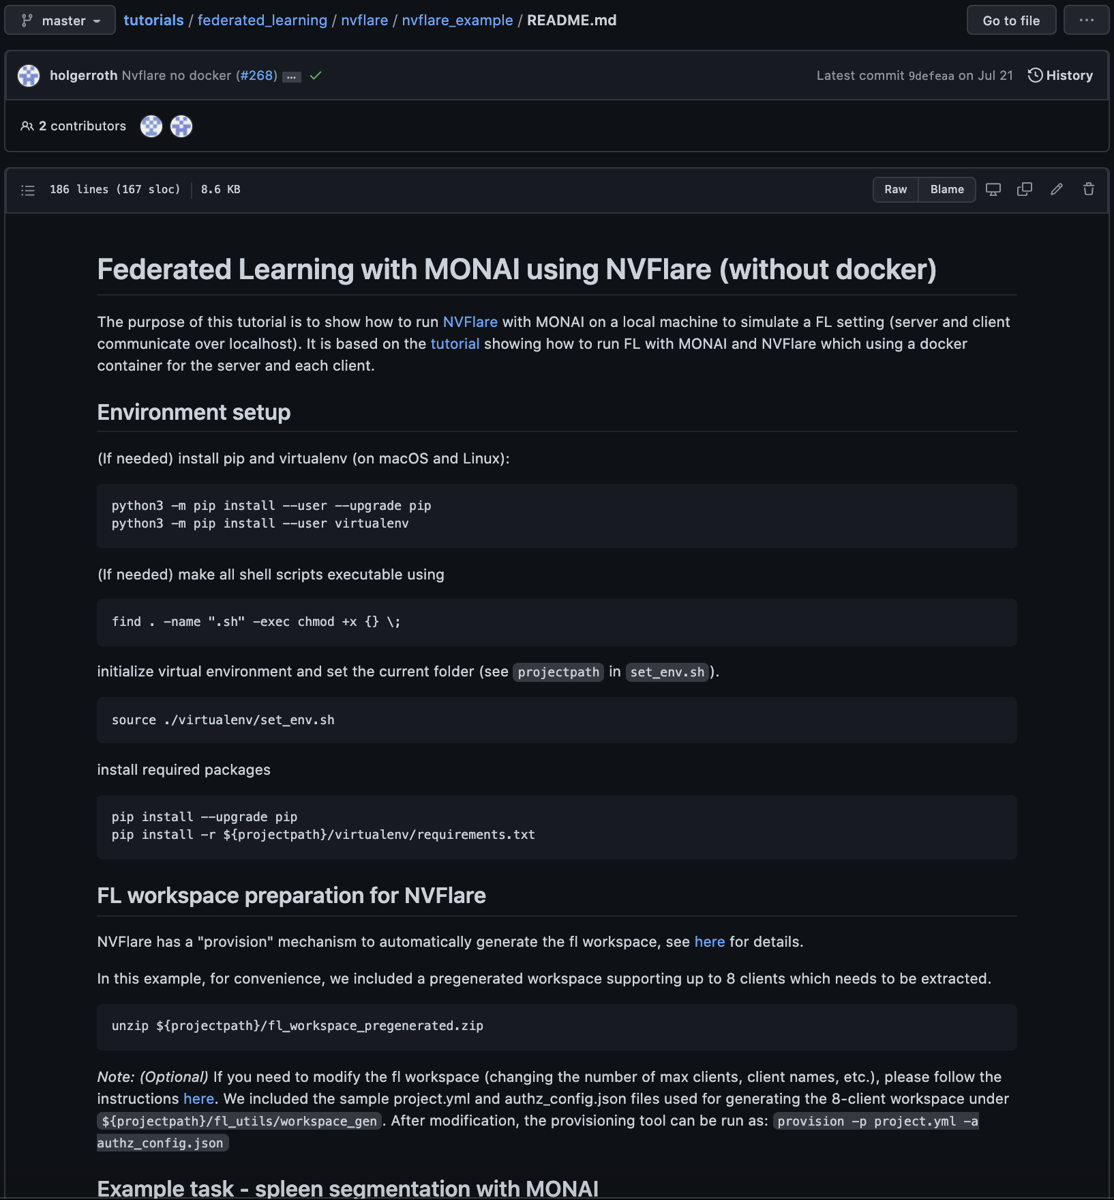

Slide 33
Questions

